Slide 1

New to the Product Overview
DYNAMICS 365 v9

Slide 2

Mitch Milam
mitch@xrmcoaches.com
@mitchmilam
linkedin.com/in/mitchmilam
youtube.com/xRMCoaches
Subscribe!

Slide 3
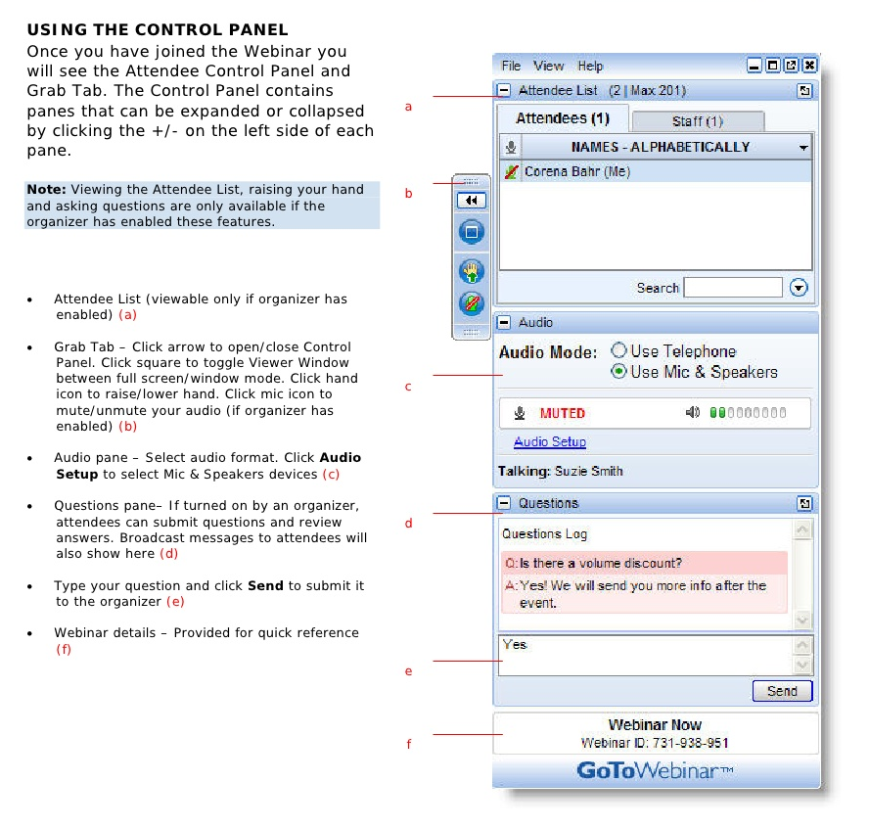
Webinar Housekeeping

Slide 4
Agenda
When
Where
Why
Technology
Tools

Slide 5
Overview
General Availability
1st week of October

Slide 6
Overview

Slide 7











Microsoft Dynamics 365
Project Service Automation
Cortana Intelligence
Power BI
Finance and Operations
Sales
Azure IoT
PowerApps
Microsoft Flow
Common Data Service
Customer Service
Talent
Marketing*
AppSource
Retail
Field Service
*Brought to you by Adobe Marketing Cloud

Slide 8
Licensing

Slide 9
Rule #1
Don’t ask me questions about licensing
Contact Microsoft
I am not a magician or a clairvoyant
** Download and review the Licensing Guide **

Slide 10
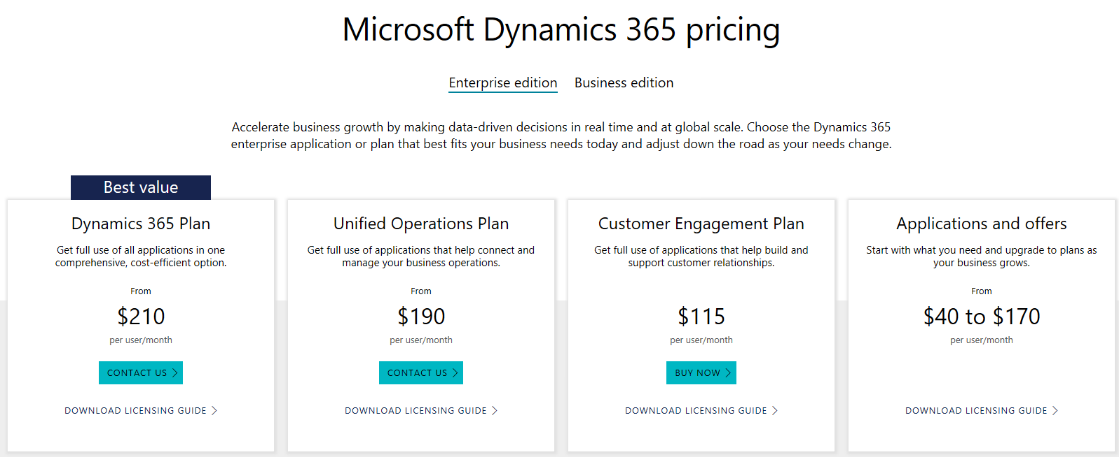
Licensing Level
https://www.microsoft.comdynamics365/pricing

Slide 11
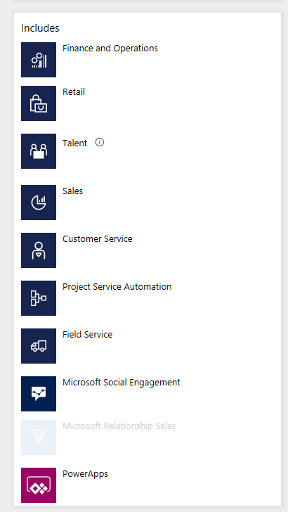
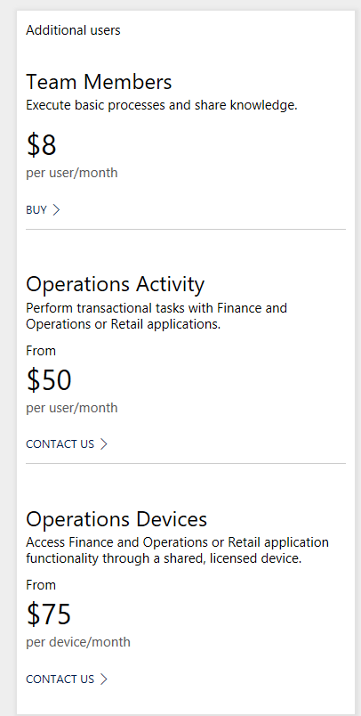
Dynamics 365 Plan

Slide 12
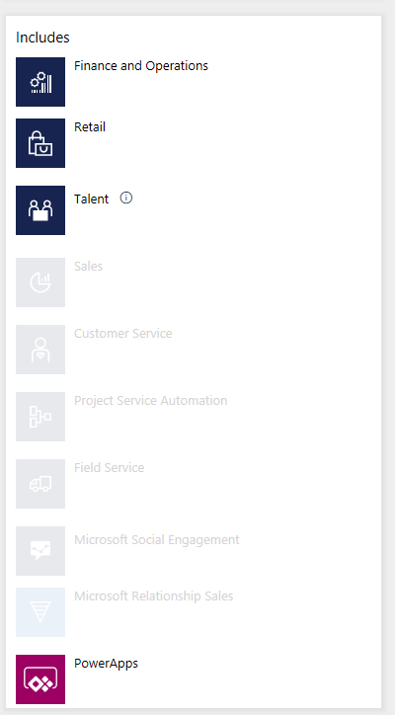
Unified Operations Plan

Slide 13
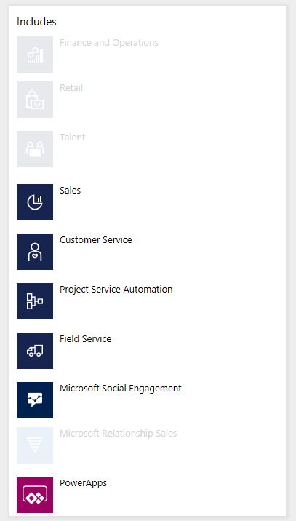
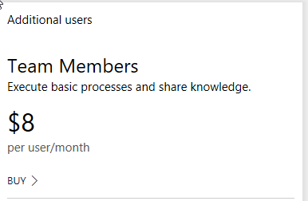
Customer Engagement Plan

Slide 14
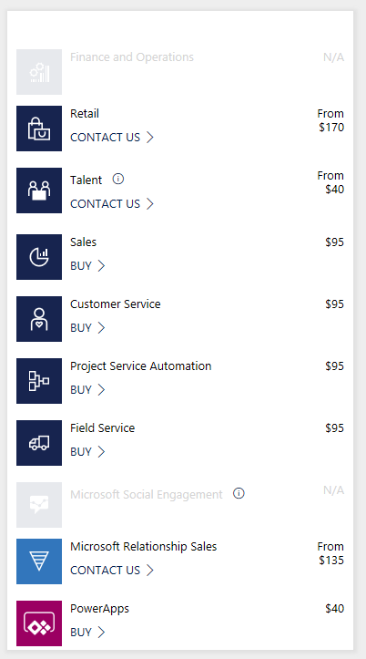
Applications and Special Offers

Slide 15
Module Overview

Slide 16
Customer Engagement
Sales
Customer Service
Project Service Automation
Field Service

Slide 17
Operations
Finance and Operations
Retail
Talent

Slide 18
Additional
Microsoft Social Engagement
Microsoft Relationship Sales

Slide 19
Primary Features

Slide 20
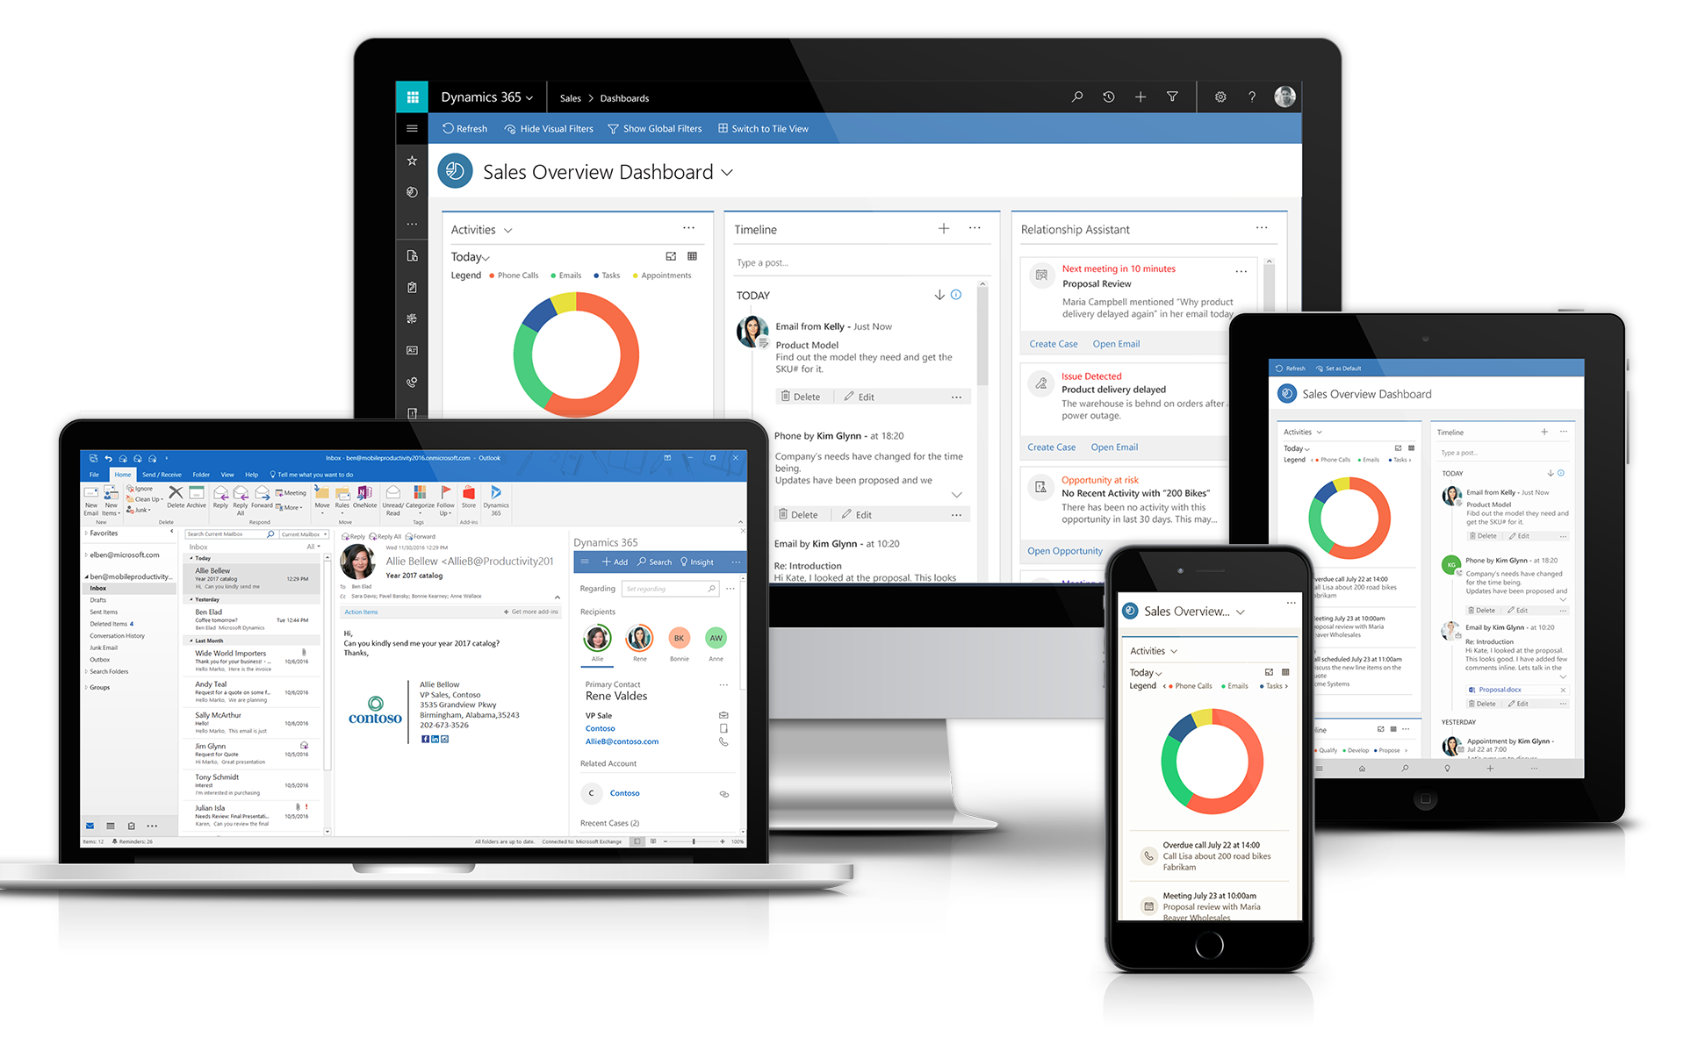
Anywhere, any device
** with built-in offline capabilities

Slide 21
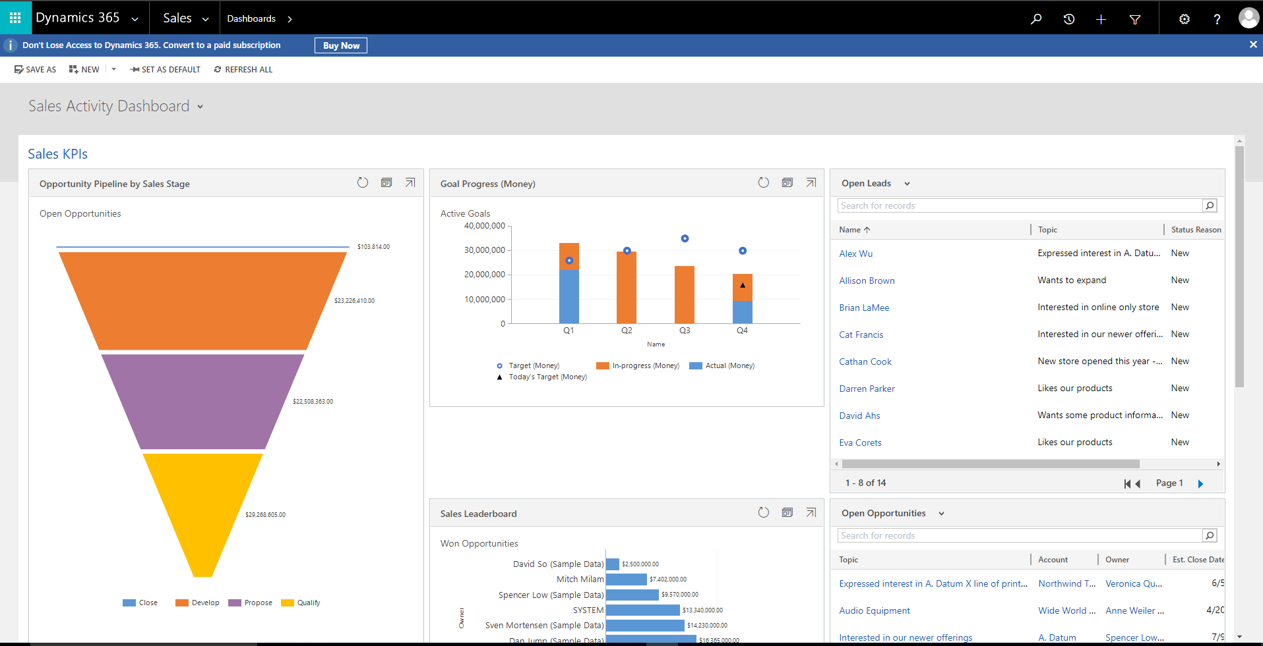
Streamlined Interface

Slide 22
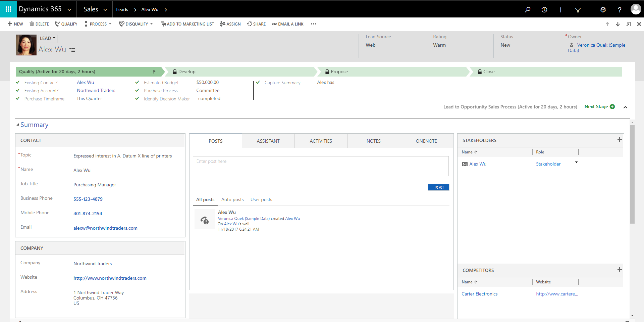
Business Process Guidance

Slide 23
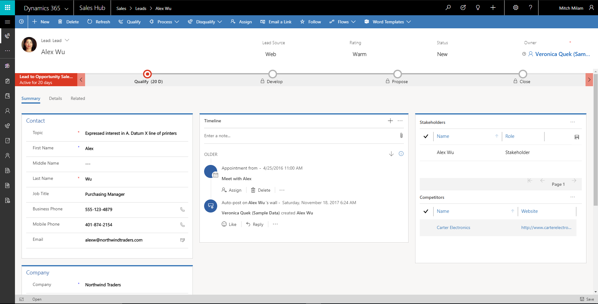
New Unified Interface

Slide 24
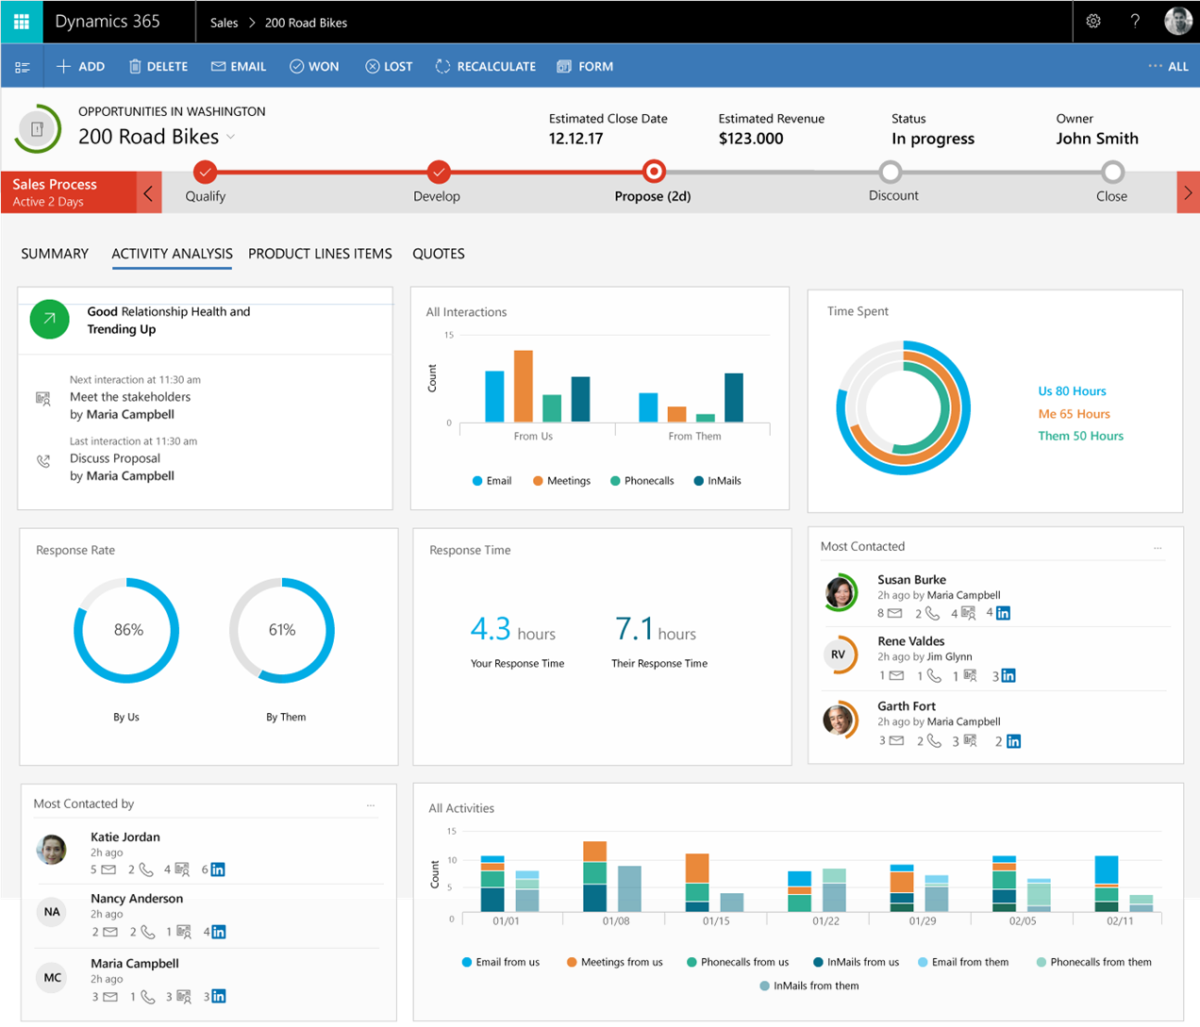
Integration
Relationship Analytics
Relationship health scoring is influenced by interactions and activities made on Linkedln Sales Navigator and Point Drive
Linkedln activities are tracked and can be holistically visualized on the Relationship Analytics dashboard together with e-mails, meeting and phone calls

Slide 25
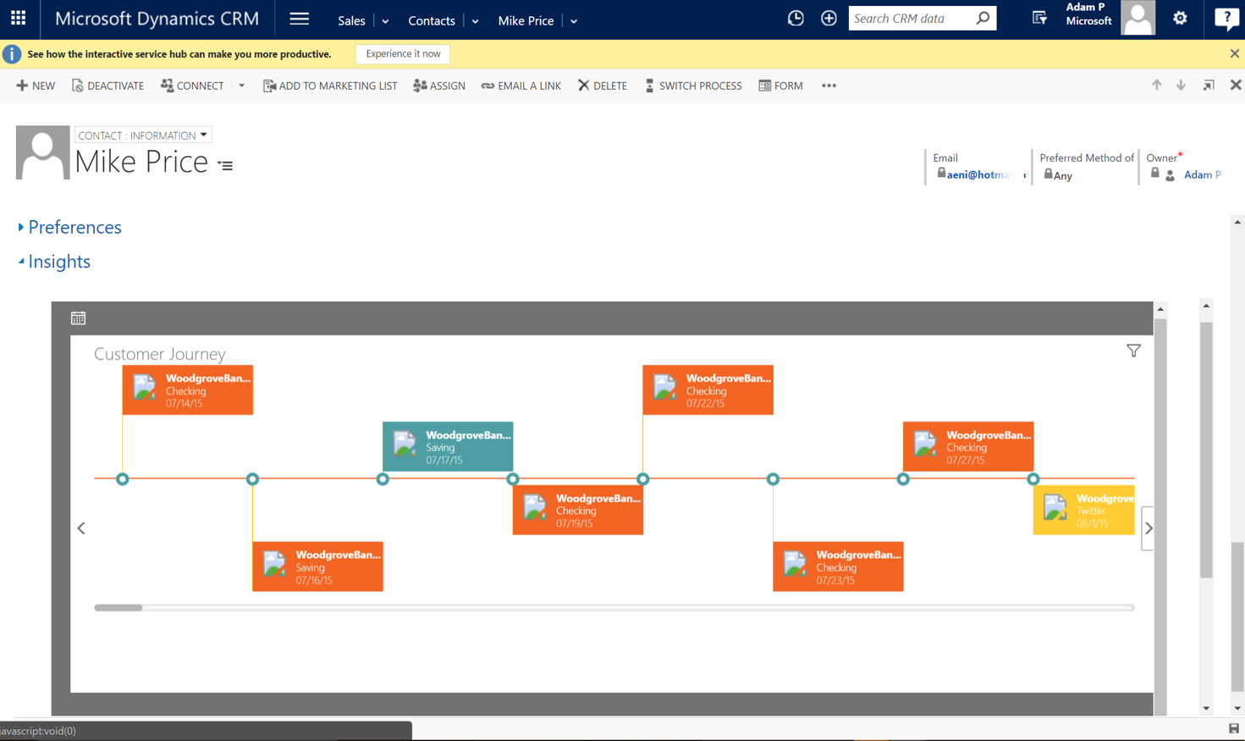
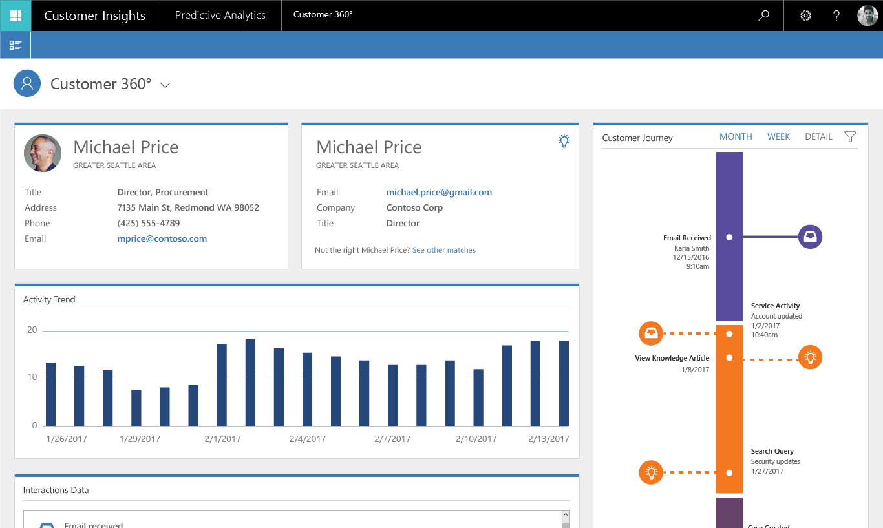
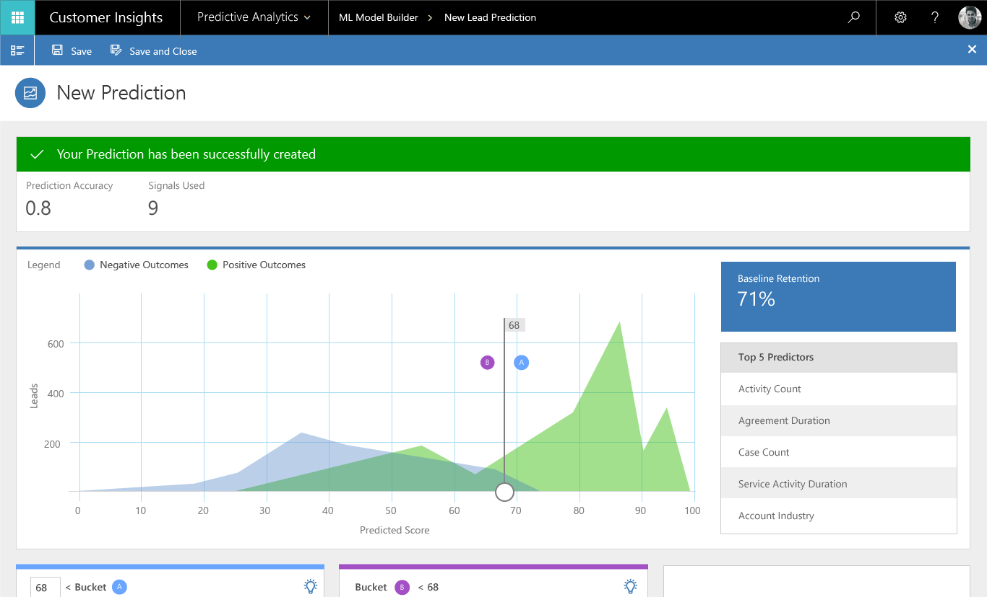
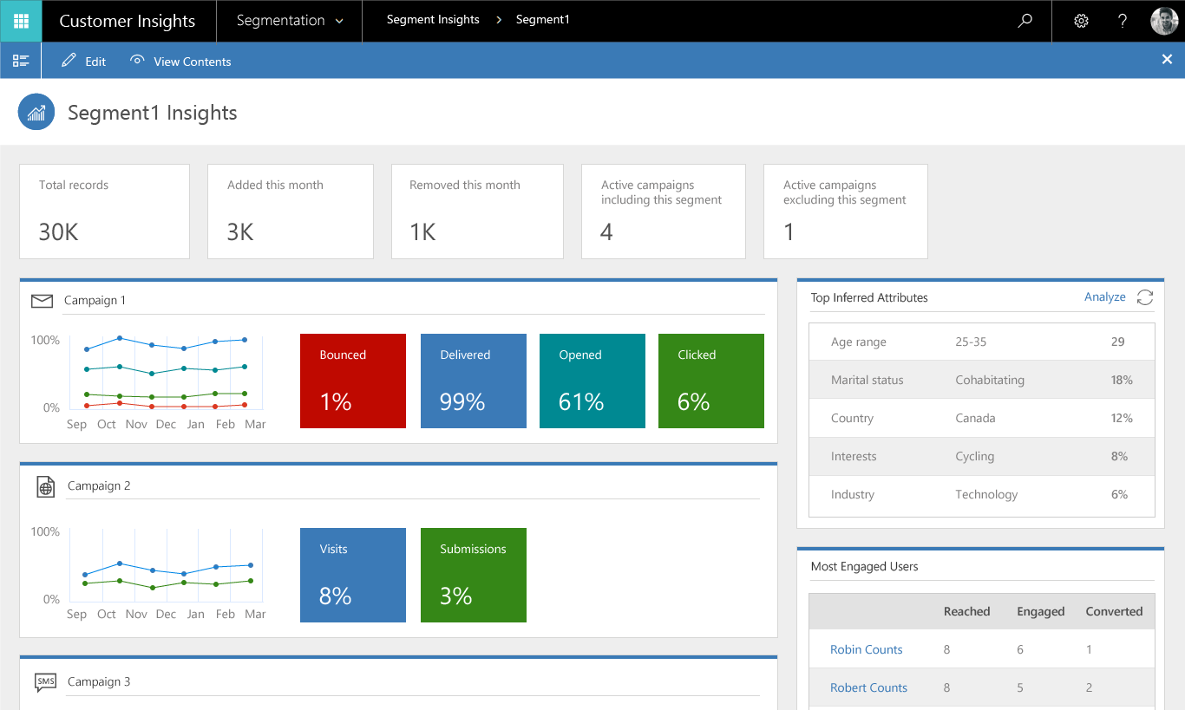
Customer Insights
Customer 360° Enhancements
Relationships, Relationship KPIs
Session Interactions
Data Inflow
Dynamics 365 online
Azure Storage
Exchange Online
Microsoft Social Engagement
Predictive Match
Match activities or profiles with customers using contextual info
Inferred links and relationships between your data
Embed Insights
Azure Storage
Power BI
Segment Export
Predictive Scoring
Predict any business outcome with advanced ML & AI
Plan efficient follow-ups with grading
Segmentation
Identify the right audience for your customers
Leverage complete customer journey to create cohorts

Slide 26
Integration

Slide 27
Dynamics 365
Dynamics 365
Digital marketing
Shipments
Orders
Projects
Forecast
Leads
Support case
Equipment maintenance
Service requests
Opportunities
Notes:
Our new Common Data Service surfaces the data stored within Dynamics 365 across a common set of entities that model data across all the Business Applications in Dynamics 365 – Sales, Customer Service, Operations, Financials, and more.
And what is great is that we also integrate entities from Office 365 in the common data service as well. <click>

Slide 28
Dynamics 365
Dynamics 365 + Office 365
Digital marketing
Tasks
Shipments
Calendar
Documents
Orders
Projects
Forecast
Leads
Email
Message
Support case
People
Meetings
Equipment maintenance
Service requests
Storage
Opportunities
Notes:
This means that if you setup meetings with a customer to discuss a Sales opportunity, the Opportunity entity in the Dynamics 365 Sales App will be automatically linked to the Meeting entity in Office 365.
And the Entities that are available in the Common Data Service go beyond just what is in Dynamics 365 and Office 365. You can add your own entities as well as integrate ones from partners.

Slide 29
Dynamics 365
Dynamics 365 + Office 365 + Partner Industry Solutions
Digital marketing
Tasks
Planograms
Shipments
Calendar
Documents
Trade promotion
Care plan
Orders
Projects
Patients
Forecast
Leads
Email
Message
Support case
People
Meetings
Vote
Equipment maintenance
Service requests
Storage
Citizen
Opportunities
Merchandise
Notes:
This gives you an incredibly powerful way to build business processes that can span across every system within your organization, and which can seamlessly extend and accelerate all your Business Apps and Productivity Solutions.

Slide 30
Microsoft Azure
Provides additional functionality to Dynamics 365
Machine Learning
Advanced Analytics
IoT

Slide 31
Business Application Platform
MEASURE
ACT
AUTOMATE
Power users
Power BI
PowerApps
Microsoft Flow

Slide 32
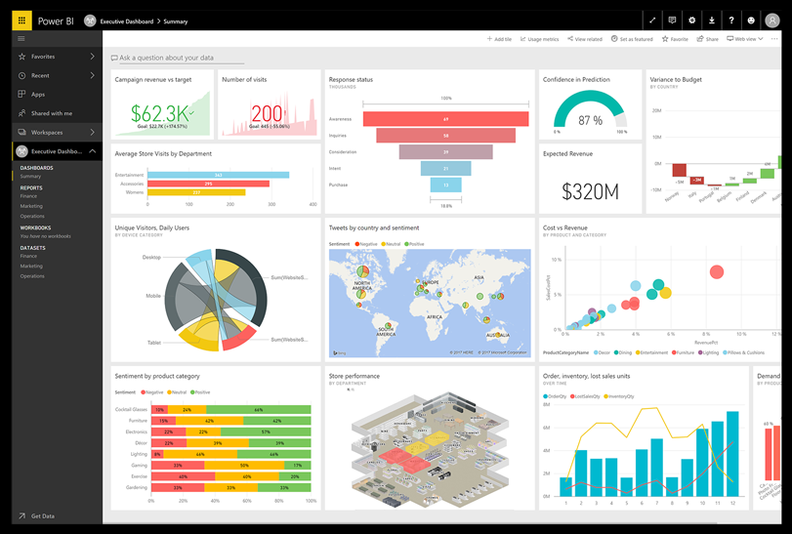
Power BI

Slide 33
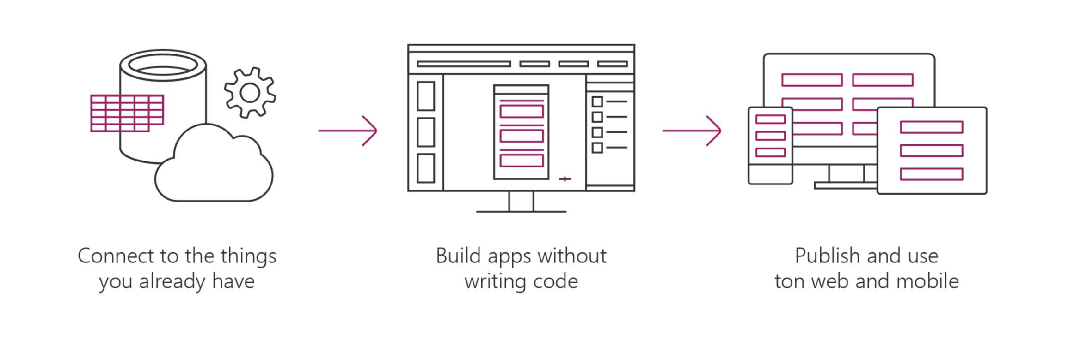
Microsoft PowerApps is a service for creating and using
custom business apps across platforms
Connect to data & systems you’re already using; create the data you need
Create apps, forms, and workflows without writing code
Use apps on web and mobile

Slide 34
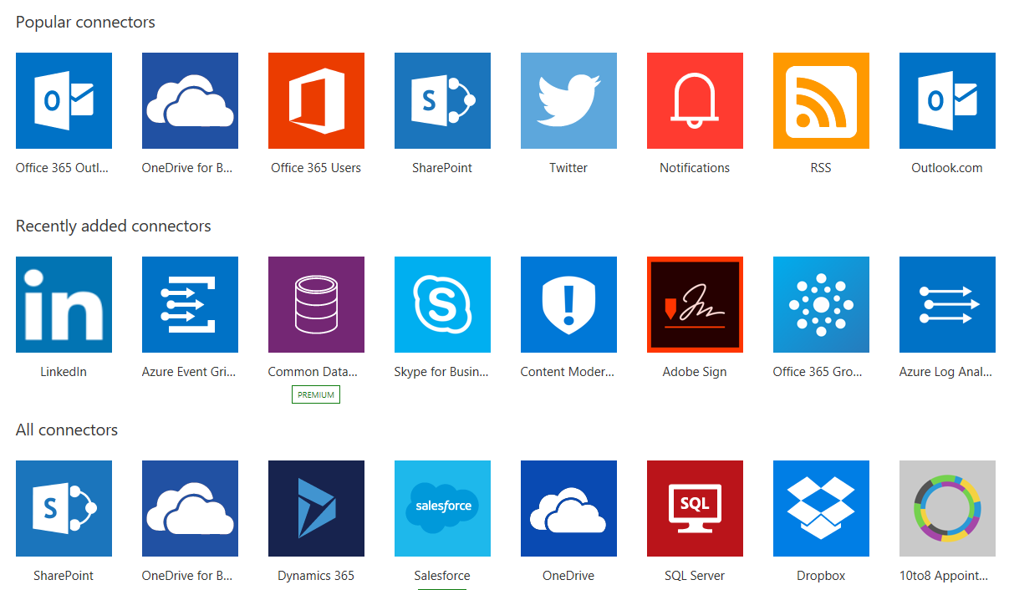
Microsoft Flow
Integrates to many different external sources
Inbound
Outbound

Slide 35
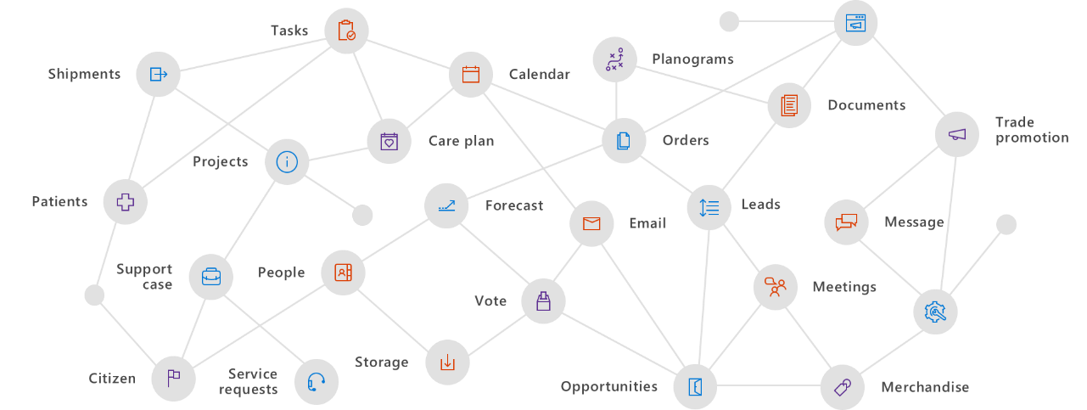
Dynamics 365 adaptability
PowerApps and Microsoft Flow bring new extensibility scenarios
Align on a common data model to build apps that span systems and processes

Slide 36
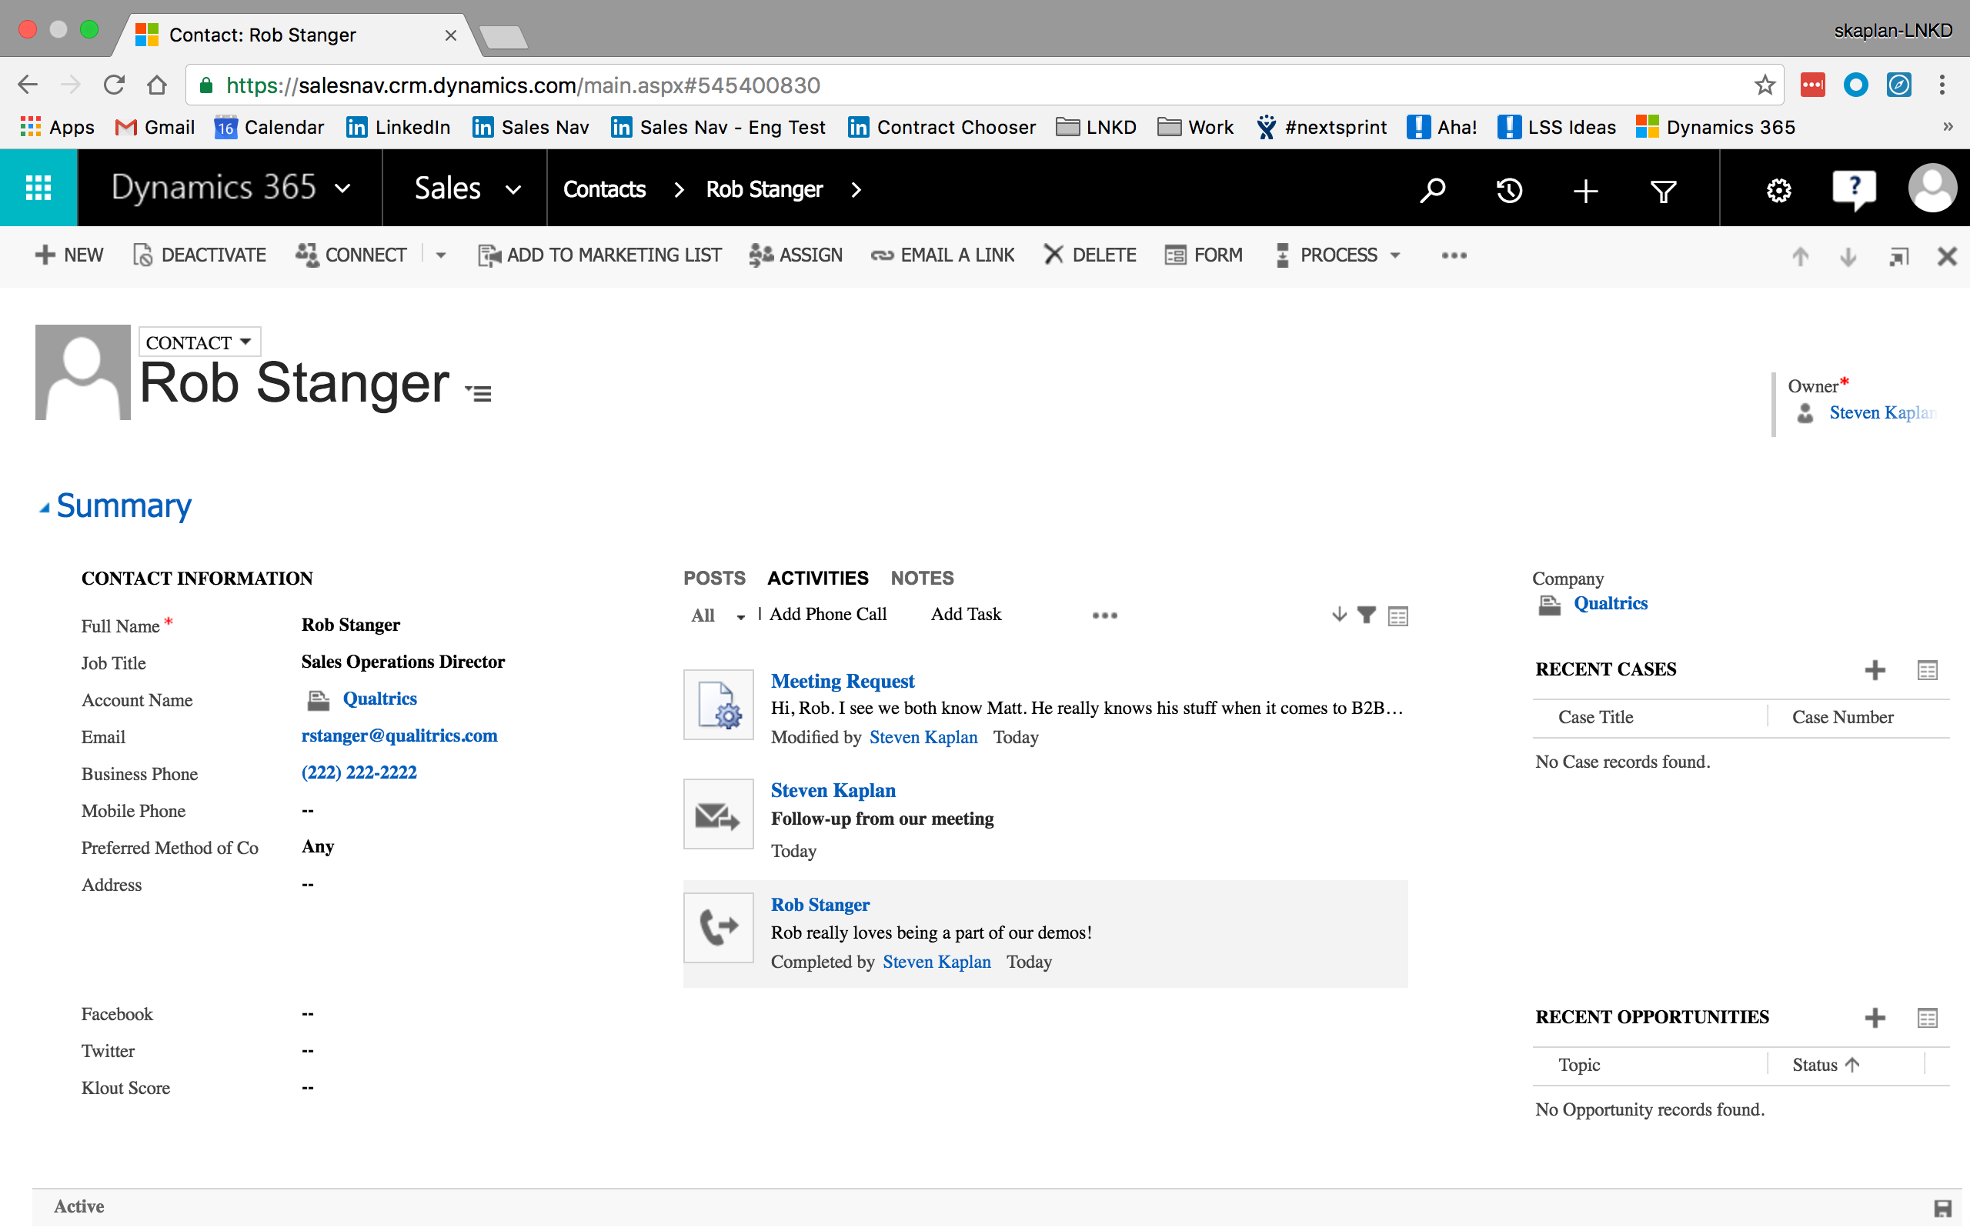
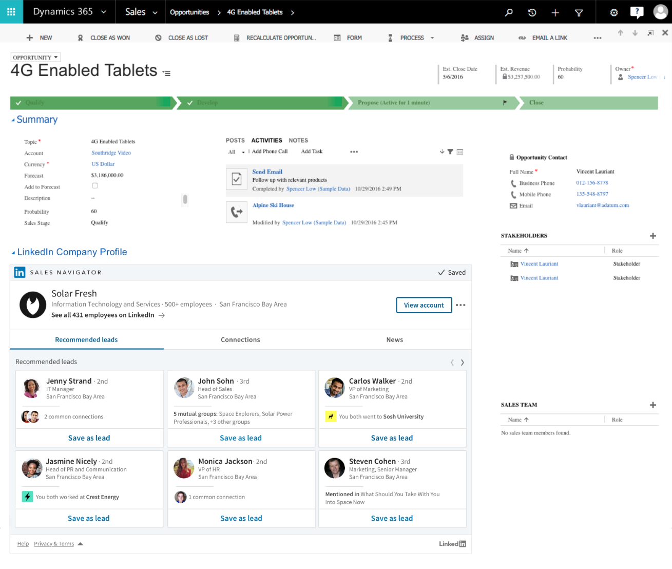
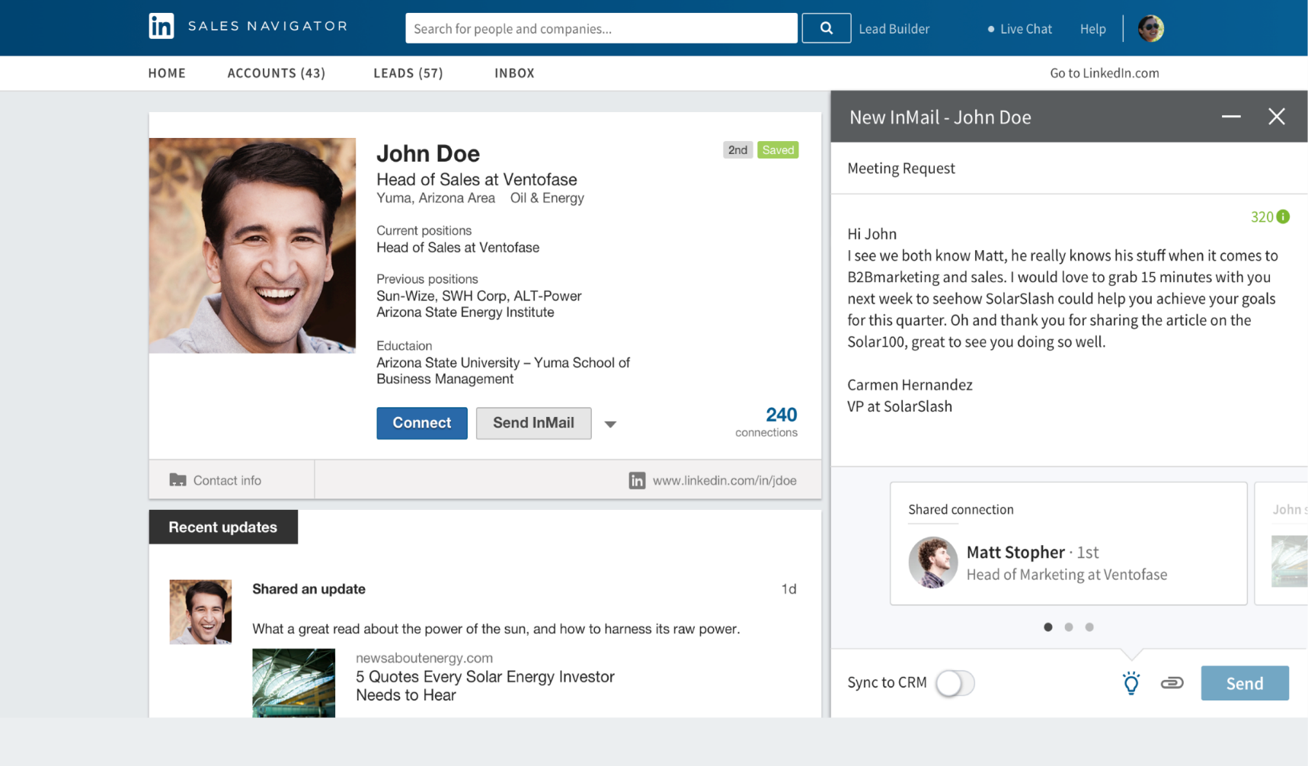
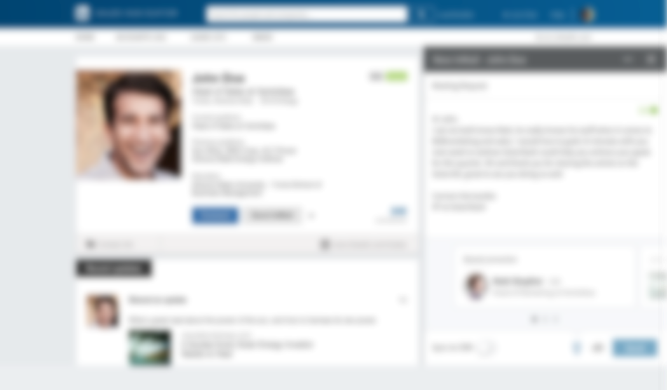
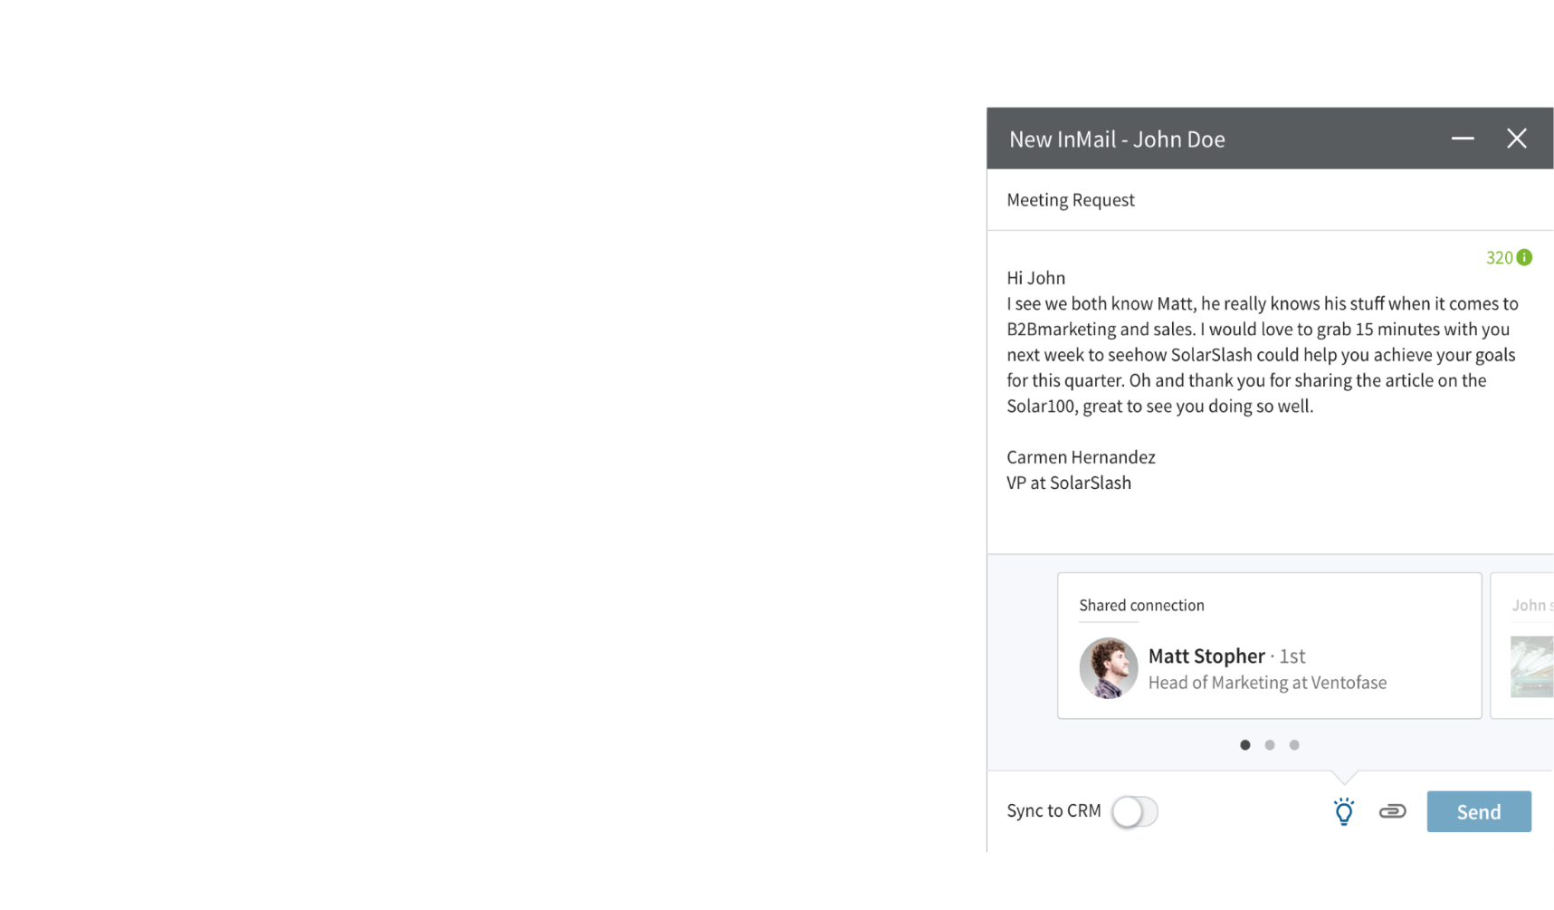




Relationship Selling with LinkedIn
Sales Navigator embedded
Enhanced Dynamics 365 widgets
Embedded contextual widgets in Dynamics 365
Social selling with context from CRM
Sync CRM data as leads in Sales Navigator with Admin Sync functionality
Receive Insights in Sales Navigator based on CRM leads
Integrated Engagement
Linkedin activities in Dynamics 365 to provide holistic engagement history
Content engagement with Pointdrive enabled with Sales Navigator

Slide 37
Planning

Slide 38
Question #1
What problem are you trying to solve?

Slide 39
Rule #2
Get a Dynamics 365 partner involved
Advice
Design
Implementation

Slide 40
Iterative Development
The Dynamics platform is tailor-made for iterative development
Use that to your advantage
Again, take small steps
Re-apply knowledge gained as you progress

Slide 41
Implementation Plan
Take small steps
Solve real problems
Keep the user community involved

Slide 42
Training/User Adoption
Develop a training plan
Get users involved

Slide 43
Configuration

Slide 44
Configuration vs. Code
Much of Dynamics 365 can be configured without writing a single line of code
The term “Customization” is often used
Customization in other products is actually writing code

Slide 45
Make it Your Own
Capture data important to your organization
New entities
New fields
Show data that is relevant to your users
Views
Forms (data entry)
Charts and Dashboards

Slide 46
Extensibility

Slide 47
Extensibility Points
PowerApps
Microsoft Flow
JavaScript
.NET

Slide 48
Next Steps

Slide 49
Next Steps
Activate a trial
https://trials.dynamics.com
Review the Dynamics roadmap
https://roadmap.dynamics.com
Do lots and lots of research
Join the CRMUG

Slide 50
Questions?

Slide 51
Thank You

